Slide 1
OFDM Transmitter and Receiver using FPGA
Jeevaram K
Rishi S Phaye
Sayan Baidya
Sukruth S

Slide 2
CONTENTS
Introduction
OFDM
Problem statement
BPSK modulation
Parameters
Plan of work and Progress
MATLAB results
Receiver results
Future work

Slide 3
Introduction
The word communication arises from the Latin word ‘commūnicāre’, which
means “to share”.
Communication can be basically defined step for exchange of
information.
In the fastest growing of the communication industry, wireless communication
technology has rapidly developed.
With this development, necessities of requirement for higher data rates and so enlarging demand on band are arisen.
Due to capacity requirements, different type of techniques are tried and applied. OFDM (Orthogonal Frequency Domain Multiplexing) resolves these needs in communication technologies.

Slide 4
OFDM
It is seen as either a modulation technique or a multiplexing technique in literature
This technology has been developed for wideband digital communication, and used for encoding of digital signal of multiple carrier frequencies.
In this technique, data is carried with orthogonal sub-carrier signals with different frequencies.
Audio broadcasting, DSL Internet Access, Wireless Networks, and in 4G mobile
communication systems are using OFDM method.
Frequency division multiplexing (FDM) extends the concept of single carrier
modulation by using multiple subcarriers within the same single channel.
The evolution of OFDM can be defined as a combination of Frequency Domain
Multiplexing (FDM) and Multi-Carrier Modulation/Communication (MCM).

Slide 5
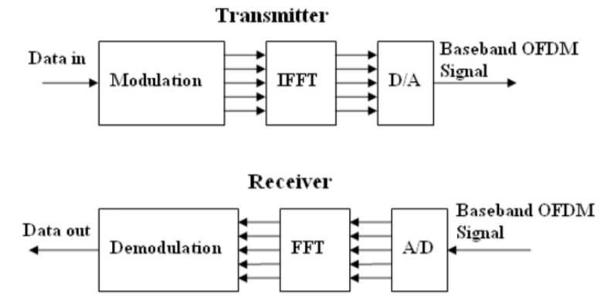
Problem Statement
Aim: Design and implement OFDM Transmitter and Receiver Using FPGA

Slide 6
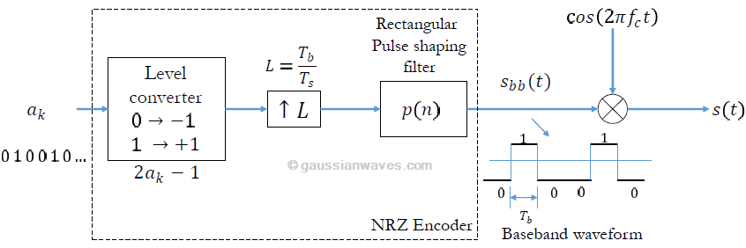
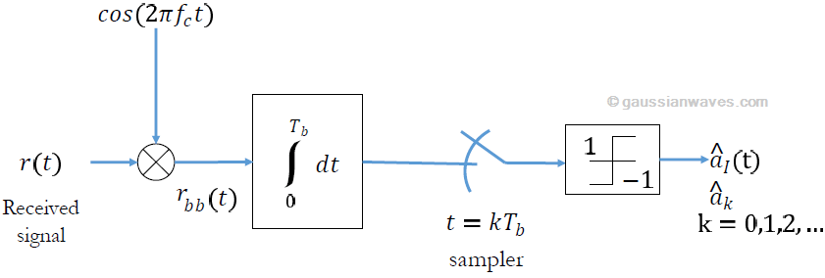
BPSK modulation

Slide 7
Parameters
Sample rate 1 Msps
Subcarrier spacing 1 kHz
FFT Length 16
Bandwidth of OFDM signal 1.4 MHz
Active Subcarriers 4
Left guard subcarriers 2
Right guard subcarriers 2
Cyclic Prefix length 8
Data symbols per frame 8
Pilots per data symbol 12

Slide 8
Plan of work and progress
Proposed
MATLAB script models for transmitter and receiver
Simulink models for the same
HDL IP core generation from previous scripts
Completed
MATLAB script models for transmitter and receiver
In progress
Simulink models for the same

Slide 9
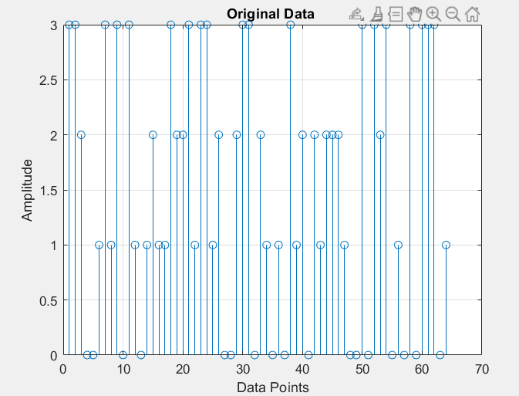
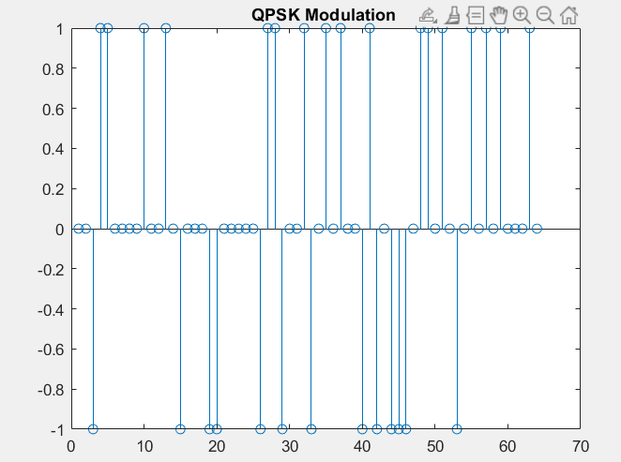
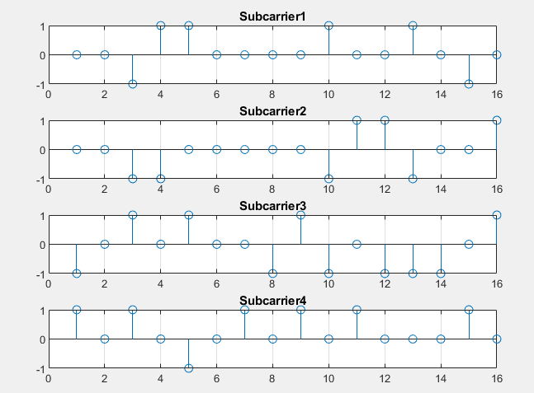
MATLAB results

Slide 10
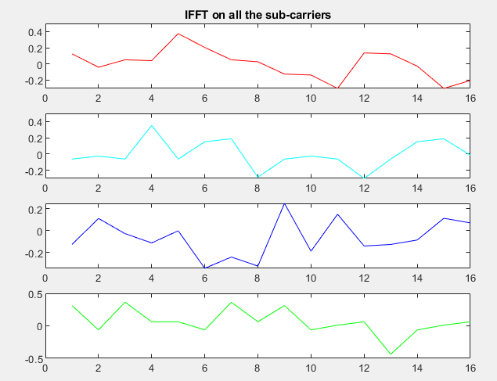
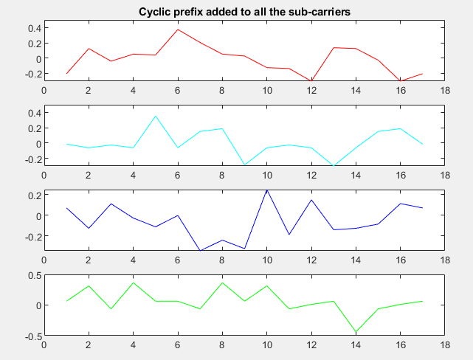
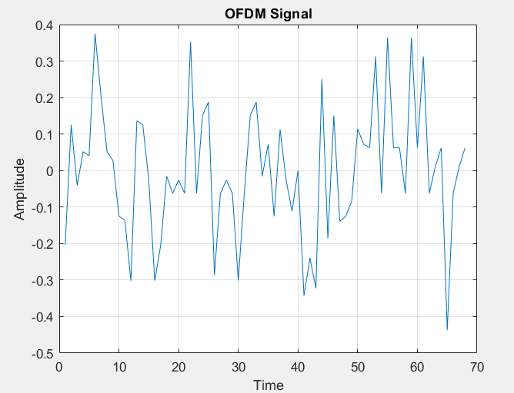
MATLAB results

Slide 11
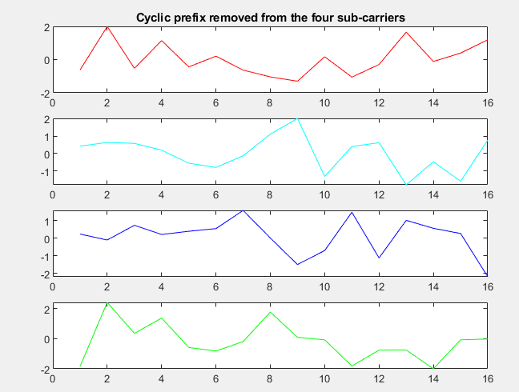
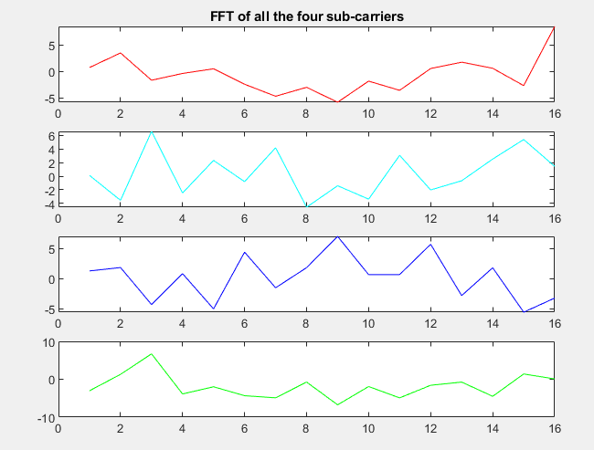
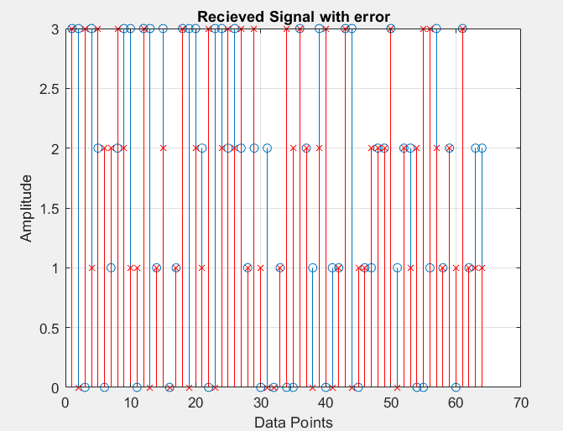
Receiver results

Slide 12
Advantages of OFDM
OFDM is an efficient way to deal with multipath; for a given delay spread, the usage complexity is essentially lower than that of a single-carrier system with an equalizer.
In relatively slow time-varying channels, it is possible to enhance capacity significantly by adapting the data rate per SC according to the signal-to-noise ratio (SNR) of that particular SC.
OFDM is robust against narrowband interference because such interference affects only a small percentage of the SCs.
OFDM makes single-frequency networks possible, which is especially attractive for broadcasting applications.

Slide 13
THANK YOU

